Slide 1

Pests and Food @NYC
Business opportunities

Slide 2
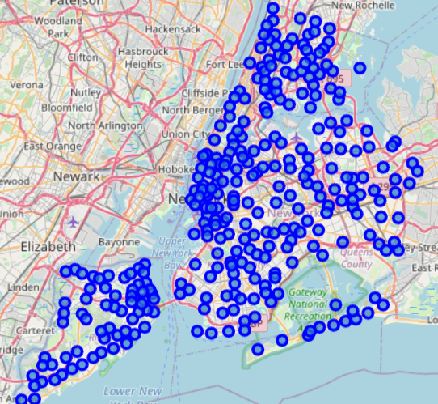
Areas in NYC

Slide 3
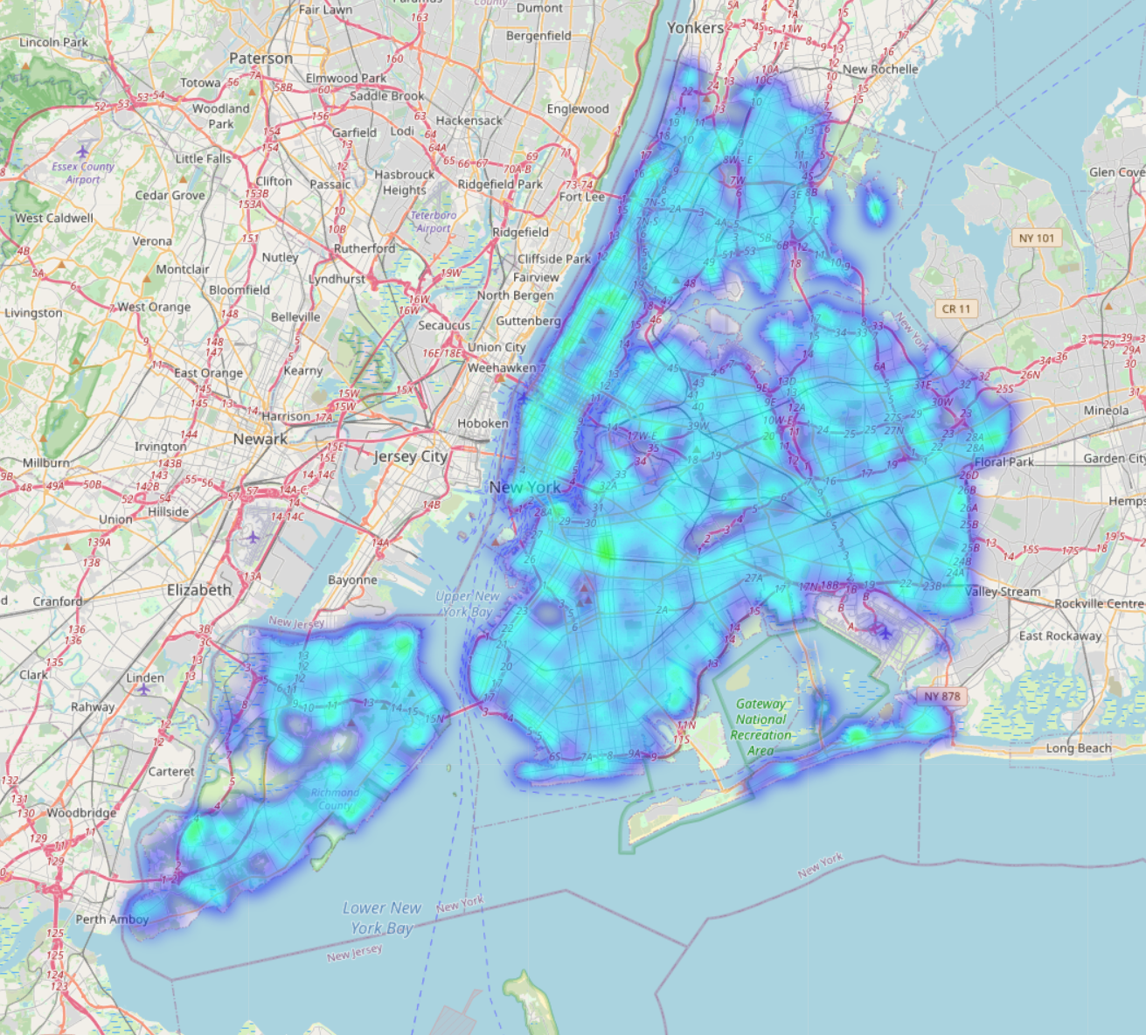
Where the pests are?

Slide 4
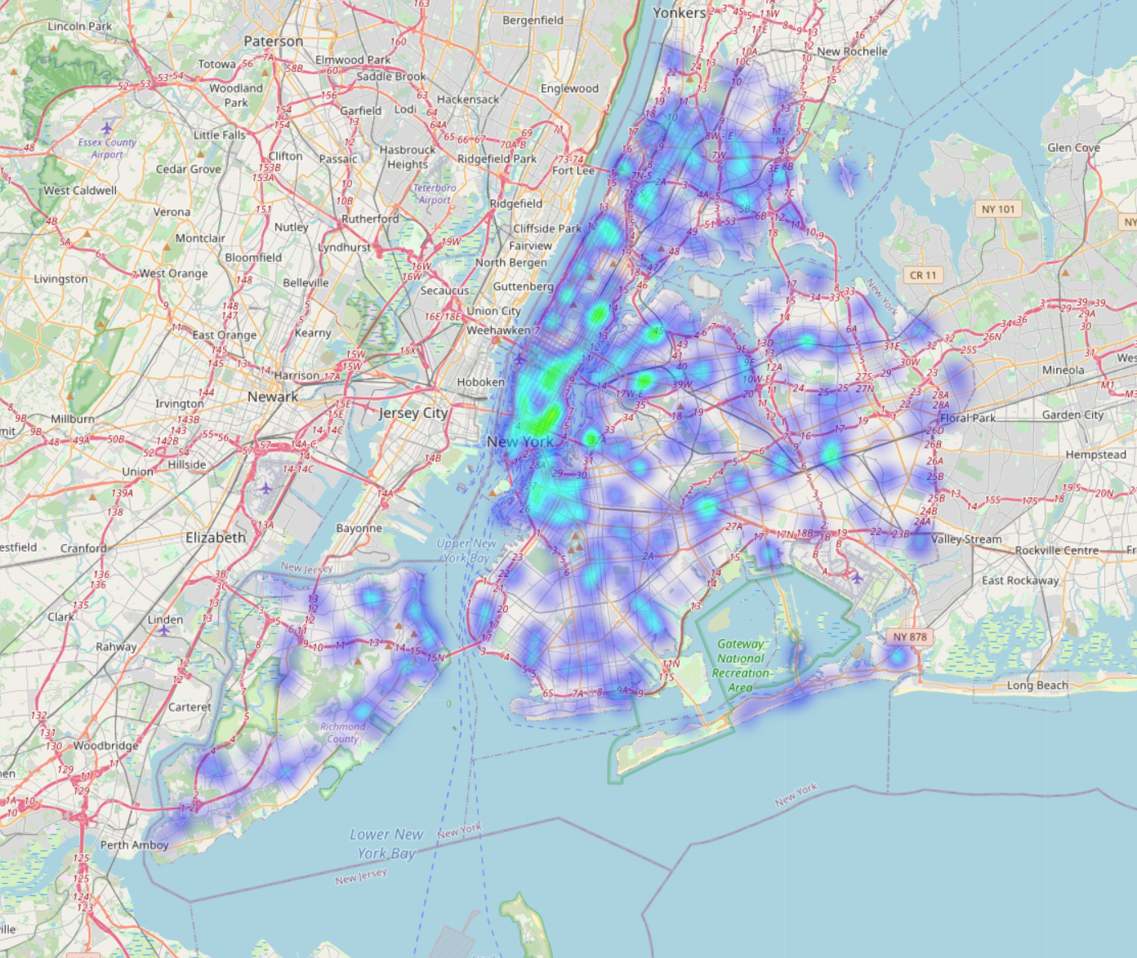
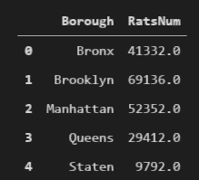
Where the business is?

Slide 5

How we measure
We use Rat/Venue x 1000 as our attractiveness KPI for this Study

Slide 6
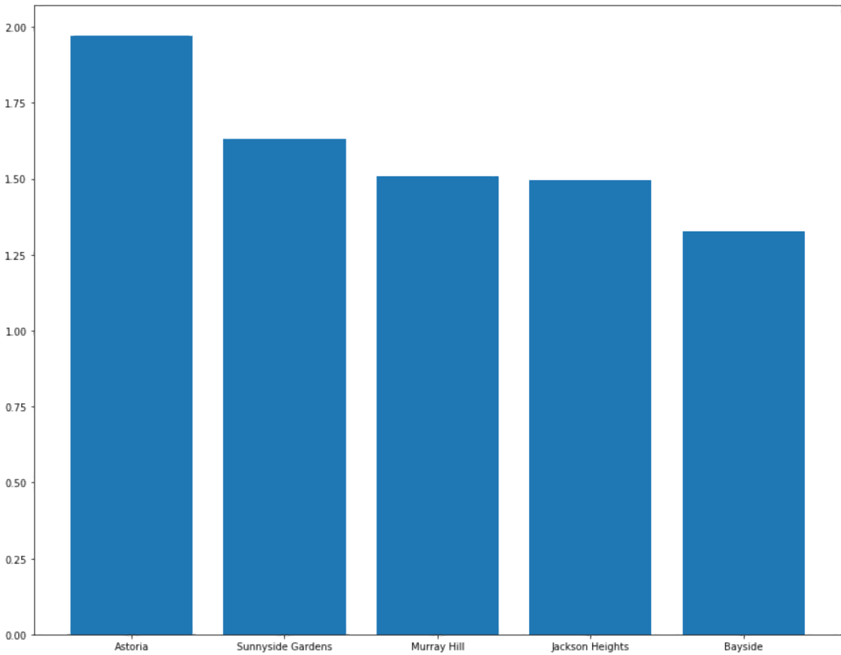
Results
Astoria is our recommendation

